Slide 1
Program Name goes here
Link to github Repository:
Links to trello board / project management tools:
You MUST provide evidence showing how the problem has been decomposed, how the components have been developed and trialled, and of how they have been assembled and tested to create a final, working outcome.

Slide 2
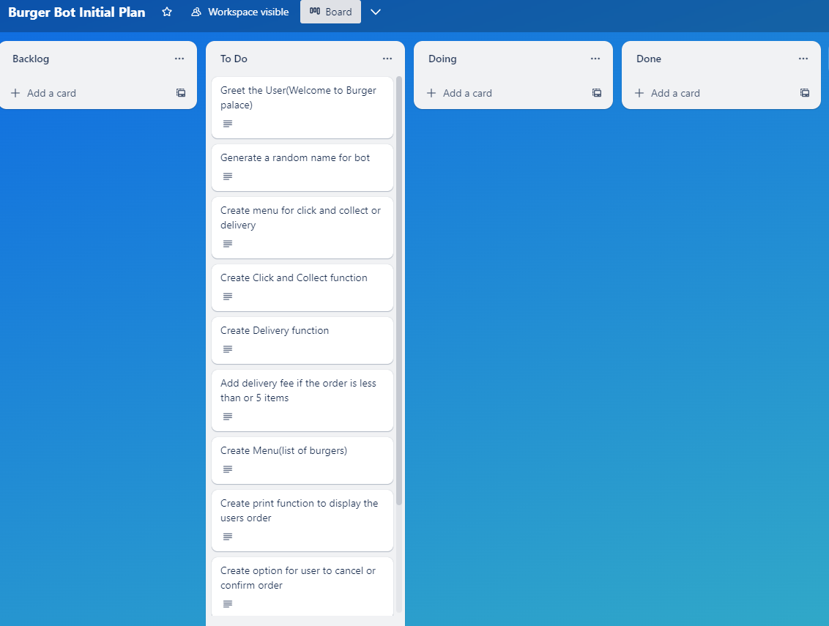
Decomposition 1 (Trello Screen Shot)

Slide 3
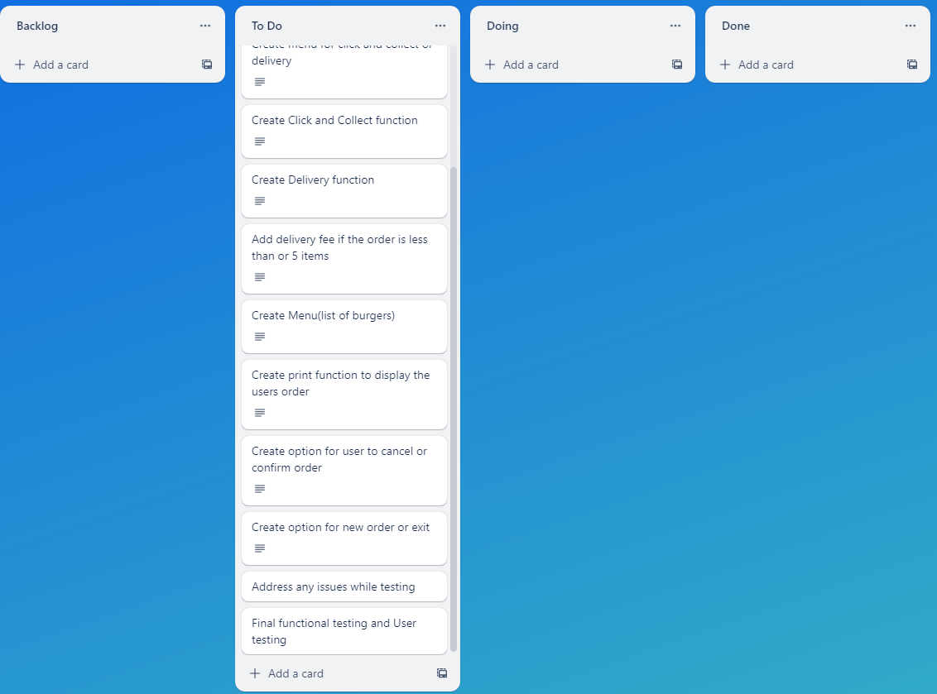
Decomposition 2 (Trello Screen Shot)

Slide 4
Relevant Implications
You must have at least 3. You can have more if you feel you need to consider more.

Slide 5
Explain the relevant implications
Implication 1
Describe the implication
Error recovery when the user has imputed something, and the program sends messages to send any solutions for the problem. So, the BOT must be able to find the problem and find a solution to it too.

Slide 6
Explain the relevant implications
Implication 1- Error Recovery
Explain why it needs to be considered
Error recovery is important as the program needs to identify the issue and be able to help the user rather than the user searching through all the information and frustrating them. It is also import because if the program does not use error recovery the user might have to re-do the program and re-enter all the information

Slide 7
Explain the relevant implications
Implication 1- Error Recovery
Explain how you plan to address the implication
To ensure the user can recover from errors I will be using value error code and the validation code to inform the user as soon as an incorrect or in-valid code has been entered

Slide 8
Explain the relevant implications
Implication 2 -Privacy
Privacy refers to the ability to provide information about oneself to a limited set of people. This would be the bot programme which cannot keep or disclose any information from options.

Slide 9
Explain the relevant implications
Implication 2
Explain why it needs to be considered
Privacy, is the right of a person to be free from interference know their personal information. It is important that this information is not stored without permission or shared with the public as information that individuals can use to track you, send phishing, etc. It is also stated in the privacy law that You may not share or store personal information without permission.

Slide 10
Explain the relevant implications
Implication 2- Privacy
Explain how you plan to address the implication:
There are many ways that we could deal with this but one of them is by ensuring the program will take out all the code and will not store it anywhere.

Slide 11
Explain the relevant implications
Implication 3 –Social Implication
Describe the implication
Social implication is when we consider our target audience and keyword usage show gender neutrality, formal and informal language.

Slide 12
Explain the relevant implications
Implication 3 -Social implication
Explain why it needs to be considered
Social implication is important because of the language itself and the keywords engage your target audience. Use gender-based words like: Him her, Her, Him, you don't appeal to all audiences because some may not associated with words like these. Language is as important as usage unofficial language on the government site would not be appropriate as it is where people get important information about the store for sale games, or burgers. Some specific slang terms could be used.

Slide 13
Explain the relevant implications
Implication 3 Social Implication
Explain how you plan to address the implication
So I will work around this by making sure we use the formel language when we try to appeal to all target audience and try to use gender-neutral terms when it asks the user to enter some information for instance.

Slide 14
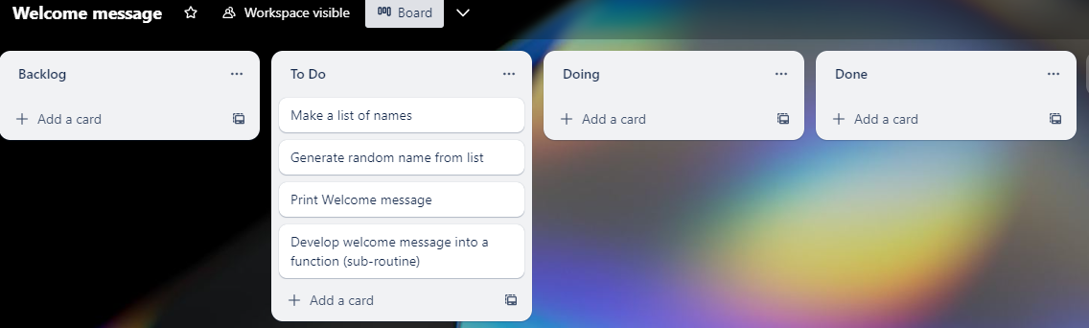
Component 1 (Trello screenshot)
Version 1

Slide 15
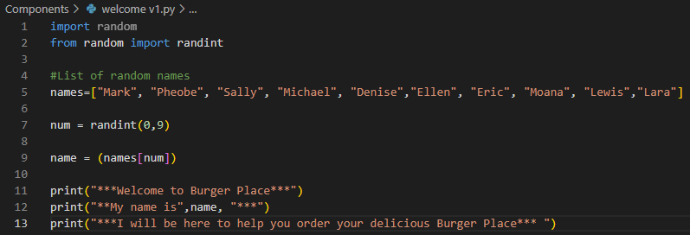
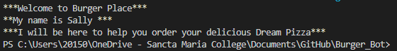
Component 1 – Welcome v1Test Plan (and screenshot)
Test Case | Expected Values
Run program to test | Print Welcome message with random names from list of names – Runs correctly

Slide 16
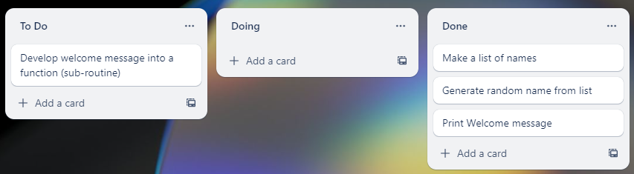
Component 1 v2 (Trello screenshot)

Slide 17
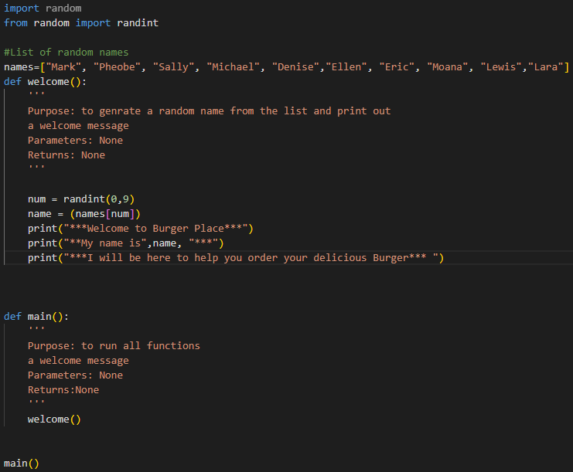
Component 1 – Welcome v2 Test Plan (and screenshot)
Test Case | Expected Values
Run program to test | Main and welcome run correctly. Welcome message prints with random name

Slide 18
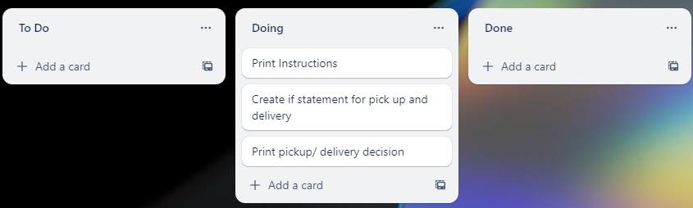
Component 2 Delivery/ click and collect Menu (Trello screenshot)

Slide 19
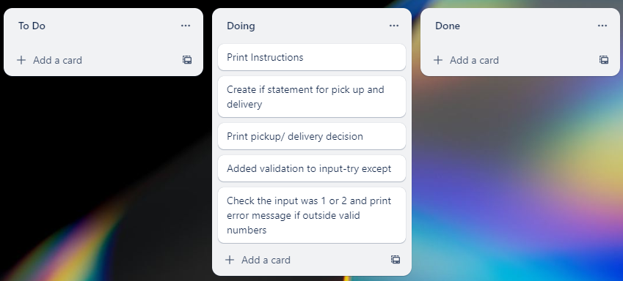
Component 2 Delivery/ click and collect Menu v2

Slide 20
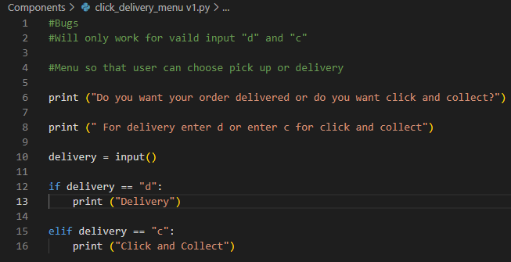
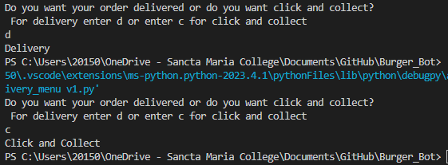
Component 2 Delivery/ click and collect Menu - Test Plan v1(?and screenshot)
Test Case | Expected Values
Run Program | If c is entered program prints click and collect If d is entered program prints delivery​

Slide 21
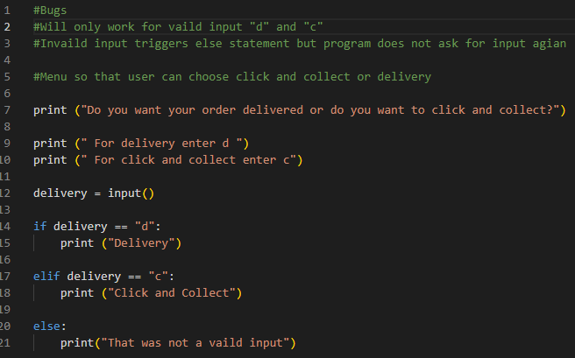
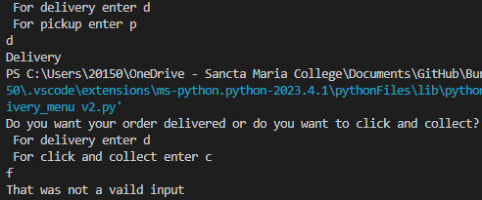
Component 2 - Test Plan v2(?and screenshot)
Test Case | Expected Values
Run Program | Enter c program prints click and collect Enter d program prints delivery​ Enter invalid program prints error message

Slide 22
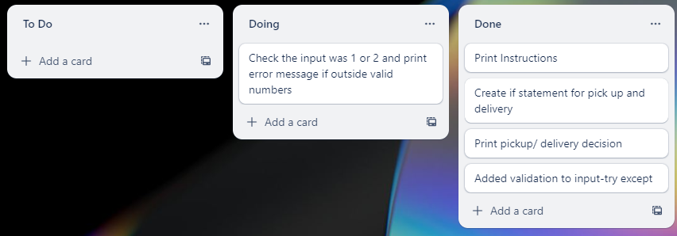
Component 2 Delivery/ click and collect Menu v3 Trello

Slide 23
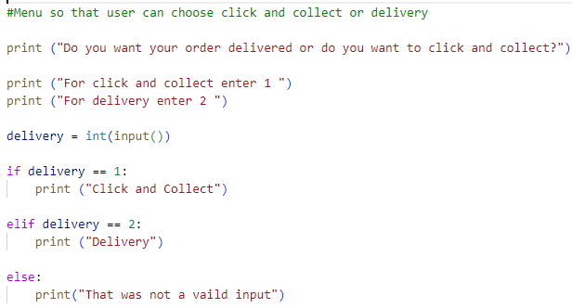
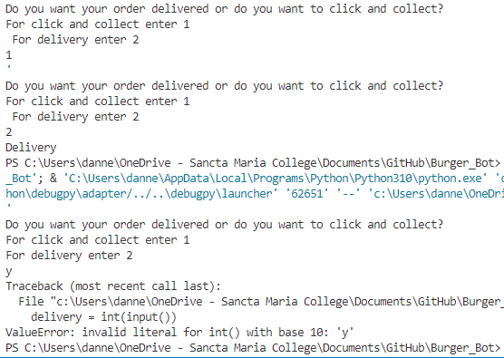
Component 2 - Test Plan v3(?and screenshot)
Test Case | Expected Values
Run Program | Enter 1 program prints click and collect Enter 2 program prints delivery​ Enter invalid, program prints value message

Slide 24
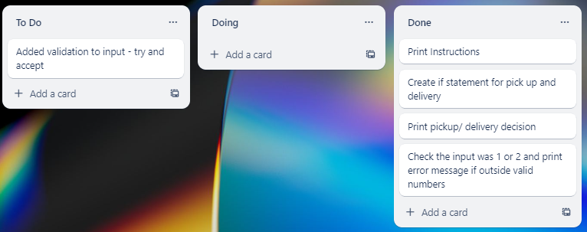
Component 2 Delivery/ click and collect Menu v4 (Trello Screenshot)

Slide 25
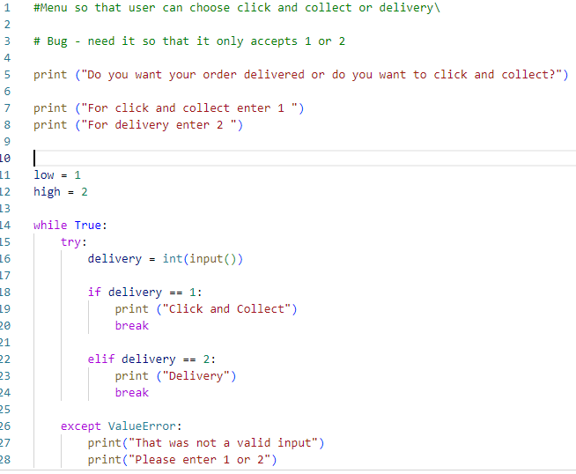
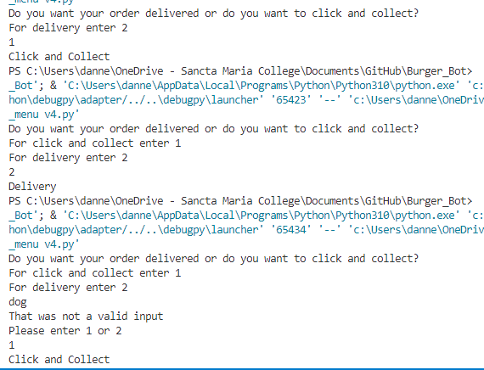
Component 2 - Test Plan v4(?and screenshot)
Test Case | Expected Values
Run Program | Enter 1 program prints click and collect Enter 2 program prints delivery​ Enter invalid, program prints value error and asks for input agian

Slide 26
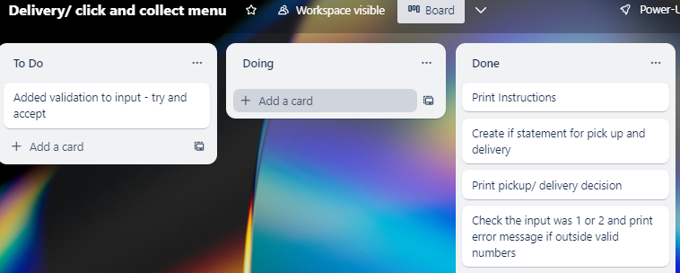
Component 2 Delivery/ click and collect Menu v4 (Trello Screenshot)

Slide 27
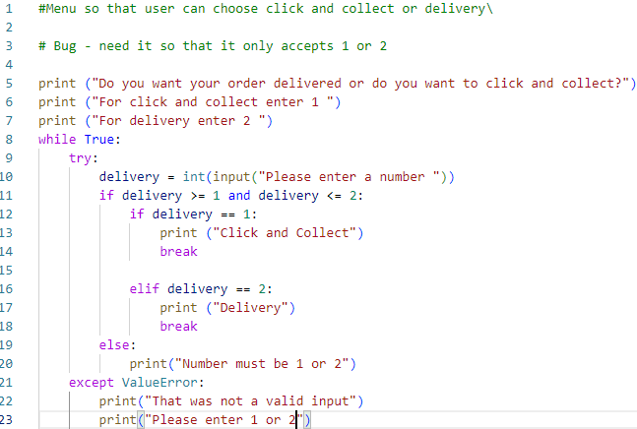
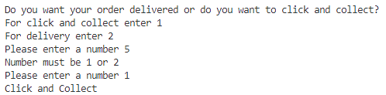
Component 2 - Test Plan v4(?and screenshot)
Test Case | Expected Values
Run Program | Enter 1 program prints click and collect Enter 2 program prints delivery​ Enter an invalid entry, the program asks for input again Enter a number other than 1 or 2, error message asks for entry again

Slide 28
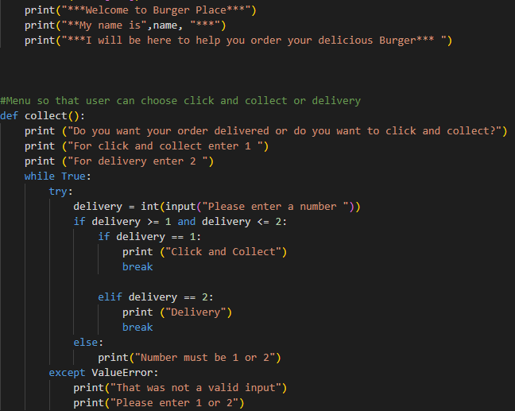
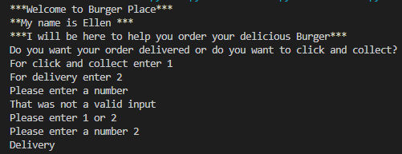
Component 2 - Test Plan Intergration into Main(?and screenshot)
Test Case | Expected Values
Run Program | Enter 1 program prints click and collect Enter 2 program prints delivery​ Enter an invalid entry, the program asks for input again Enter a number other than 1 or 2, error message asks for entry again Printed everything as expected

Slide 29
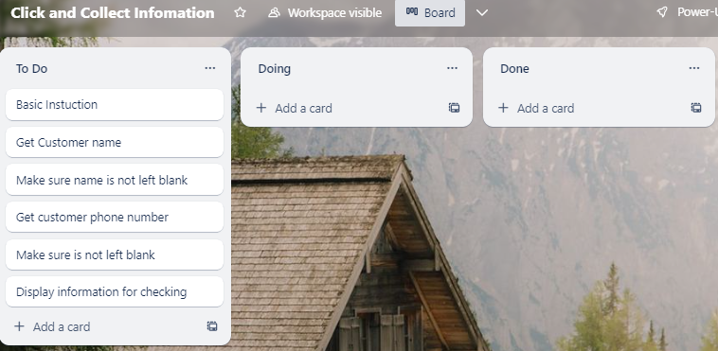
Component 3 Click and Collect Information v1 (Trello screenshot)

Slide 30
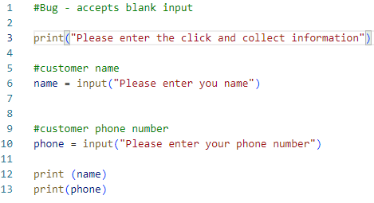
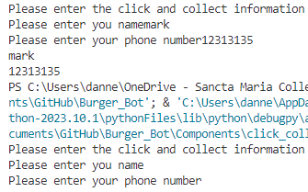
Component 3 version1 - Test Plan (?and screenshot)
Test Case | Expected Values
Input name Input phone number Left input blank | Printed name correctly Printed phone number Accepted blank and printed blank input

Slide 31
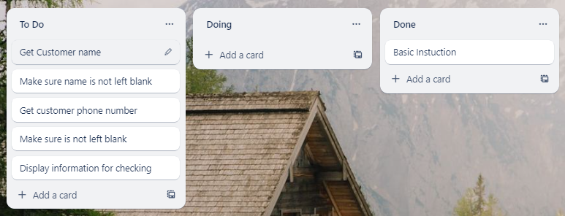
Component 3 Click and Collect info v2(Trello screenshot)

Slide 32
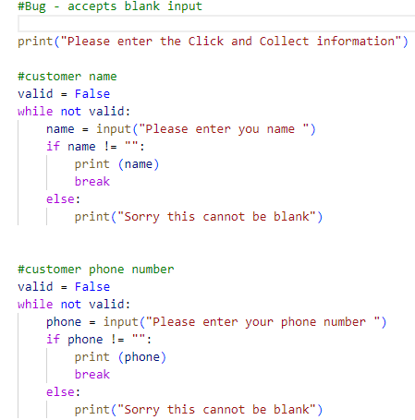
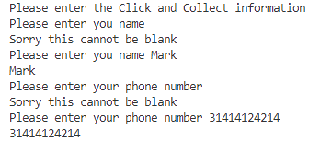
Component 3 version 2 - Test Plan (?and screenshot)
Test Case | Expected Values
Input name Input phone number Left Input blank | Printed name correctly Printed phone number Prints “Sorry this cannot be blank”- goes back to input

Slide 33
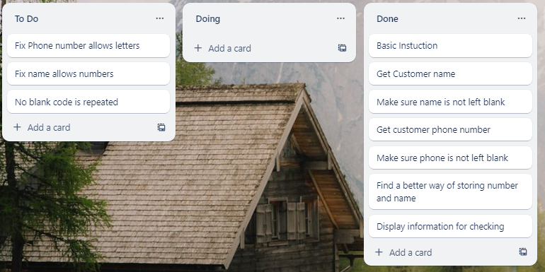
Component 3 Click and Collect info v3(Trello screenshot)

Slide 34
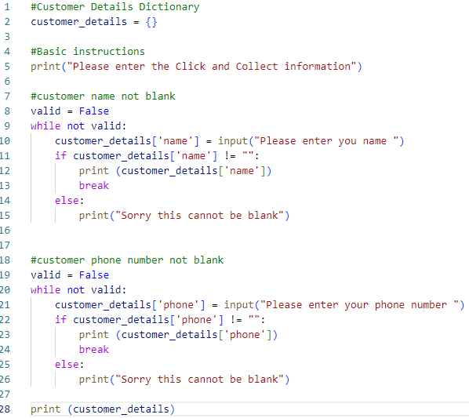
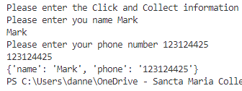
Component 3 version 3 - Test Plan (?and screenshot)
Test Case | Expected Values
Input name Input phone number Left Input blank | Printed name correctly Printed phone number Prints “Sorry this cannot be blank”- goes back to input

Slide 35
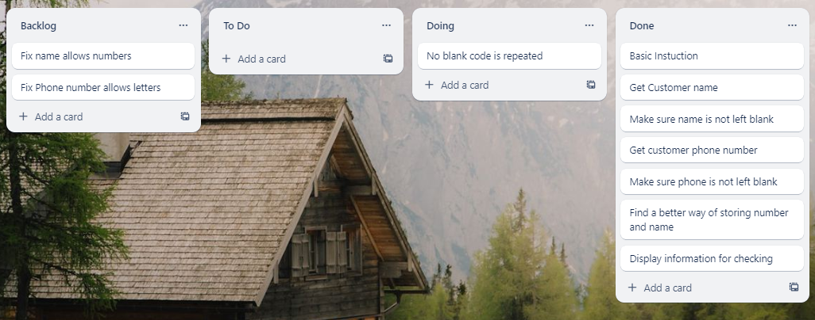
Component 3 Click and Collect info v4(Trello screenshot)

Slide 36
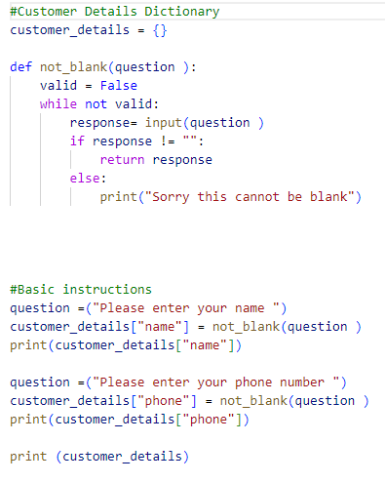
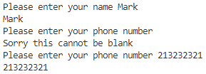
Component 3 version 4 - Test Plan (?and screenshot)
Test Case | Expected Values
Input name Input phone number Left Input blank | Printed name correctly Printed phone number Prints “Sorry this cannot be blank”- goes back to input

Slide 37
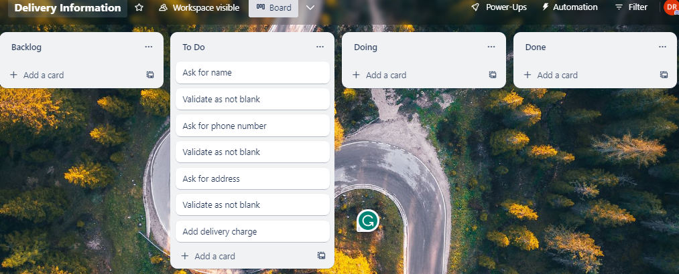
Component 4 Delivery Information v1 (Trello screenshot)

Slide 38
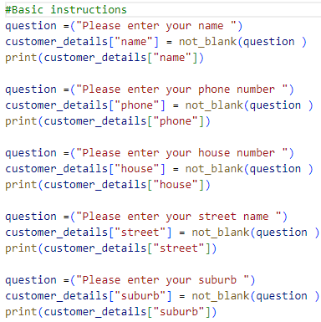
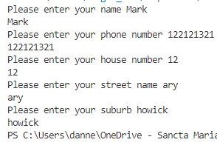
Component 4 - Test Plan (?and screenshot)
Test Case | Expected Values
Input name Input phone number Input house number Input street name Input suburb Left Input blank | Printed name correctly Printed phone number Prints house number Printed street name Printed suburb name Prints “Sorry this cannot be blank” – goes back to input

Slide 39
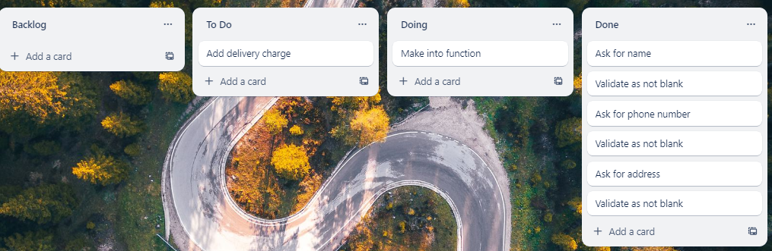
Component 4 Delivery Information v2 (Trello screenshot)

Slide 40
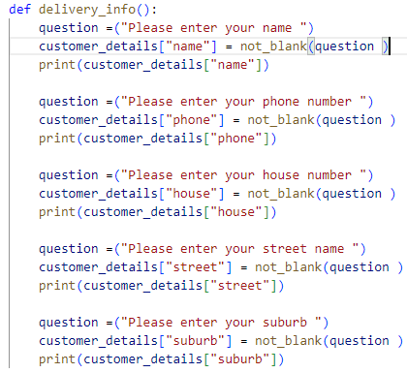
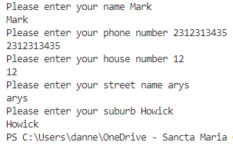
Component 4 version 2 - Test Plan (?and screenshot)
Test Case: Test after making into function | Expected Values
Input name Input phone number Input house number Input street name Input suburb Left Input blank | Printed name correctly Printed phone number Prints house number Printed street name Printed suburb name Prints “Sorry this cannot be blank” – goes back to input

Slide 41
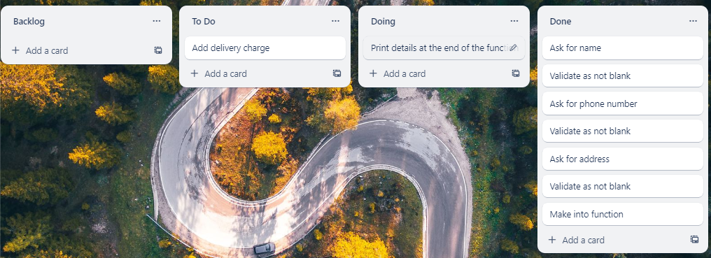
Component 4 Delivery Information v3 (Trello screenshot)

Slide 42
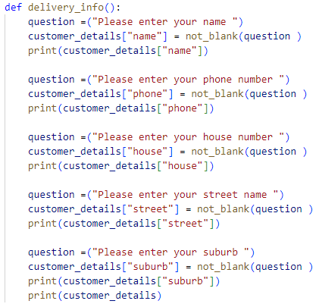
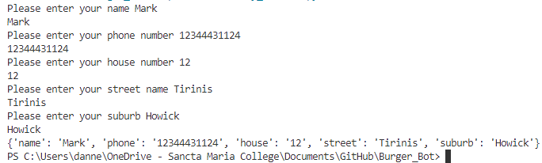
Component 4 version 3 - Test Plan (?and screenshot)
Test Case: Test after making into function | Expected Values
Input name Input phone number Input house number Input street name Input suburb Left Input blank | Printed name correctly Printed phone number Prints house number Printed street name Printed suburb name Prints “Sorry this cannot be blank” – goes back to input

Slide 43
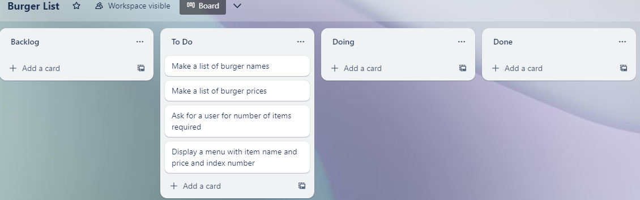
Component 5 Burger List v1 (Trello screenshot)

Slide 44
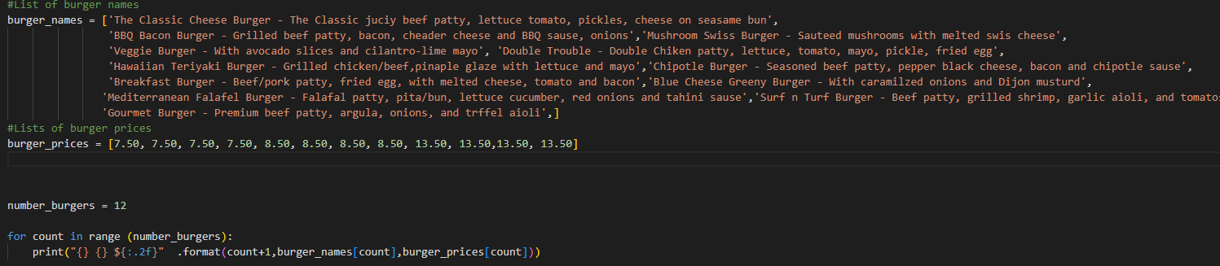
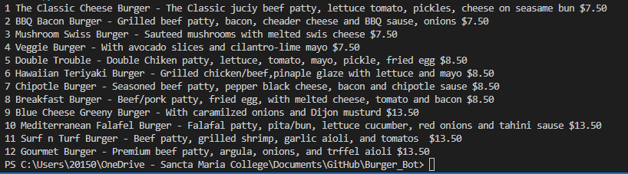
Component 5 Burger List v1 - Test Plan ( screenshot)
Test Case | Expected Values
Run file | Printed a list with index number, pizzas and prices

Slide 45
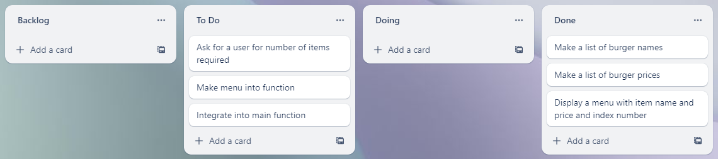
Component 5 Burger List v2 (Trello screenshot)

Slide 46
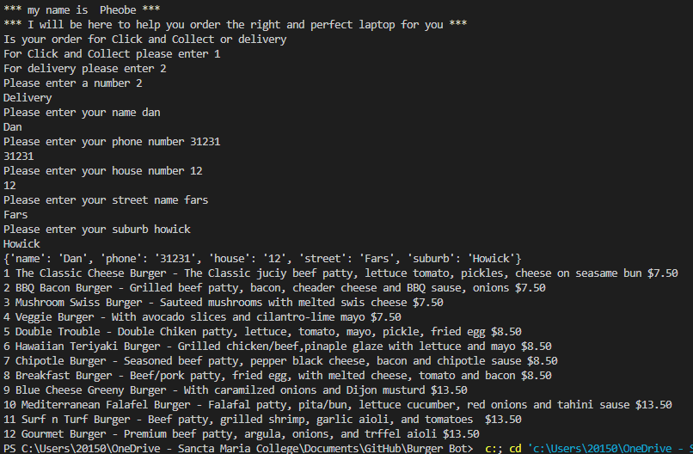

Component 5 Burger List v2 Intergration - Test Plan ( screenshot)
Test Case | Expected Values
Run file | Printed a list with index number, pizzas and prices with price formatted to 2 decimal places and dollar sign. Menu starts at 1

Slide 47

Component 6 – Ordering from burger list v1 (Trello screenshot)

Slide 48


Component 6 – Ordering from burger list v1 - Test Plan ( screenshot)
Test Case | Expected Values
Entered 5 burgers Typing bat Chose number 1 cheese burger | Stepped through the list the amount that I entered Program broke Printed BBQ burger instead

Slide 49

Component 6 – Ordering from burger list v2 (Trello screenshot)

Slide 50


Component 6 – Ordering from burger list v2 - Test Plan ( screenshot)
Test Case | Expected Values
Entered number of laptops I wished for Shows the information for entered index number | Stepped through the list the amount that I entered Printed information as I typed in each number

Slide 51

Component 6 – Ordering from burger list v3 (Trello screenshot)

Slide 52


Component 6 - Test Plan Ordering from burger list v3 (?and screenshot)
Test Case | Expected Values
Entered w Entered special character % Entered 15 Entered number 1 | Printed This is not a valid number Printed This is not a valid number Printed Your order must be between 1 and 12 Continues with program asking for the next burger

Slide 53

Component 6 – Ordering from burger list v4 (Trello screenshot)

Slide 54


Component 6 - Test Plan Ordering from burger list v4 (?and screenshot)
Test Case | Expected Values
Entered 2 Entered number 1 Entered number 5 | Asked me what laptops I wanted Printed the correct one Printed the correct one

Slide 55

Component 7 Printing out Order – v1 (Trello screenshot)

Slide 56

Component 7 - Test Plan Printing out Order – v1 (?and screenshot)
Test Case | Expected Values
Ran test data | Prints all correctly

Slide 57

Component 7 Printing out Order – v2 (Trello screenshot)

Slide 58


Component 7 - Test Plan Printing out Order – v2 (?and screenshot)
Test Case | Expected Values
Ran test data | Prints test details but requires more formatting

Slide 59

Component 7 Printing out Order – v3 (Trello screenshot)

Slide 60


Component 7 - Test Plan Printing out Order – v3 (?and screenshot)
Test Case | Expected Values
Ran test data | Prints test details on separate lines and has good formatting too

Slide 61

Component 7 Printing out Order – v4 (Trello screenshot)

Slide 62


Component 7 - Test Plan Printing out Order – v4 (?and screenshot)
Test Case | Expected Values
Ran test data | The function prints details on separate lines with formatting, calculated cost was correct too

Slide 63

Component 7 Printing out Order – v5 (Trello screenshot)

Slide 64



Component 7 - Test Plan Printing out Order – v5 (?and screenshot)
Test Case | Expected Values
Chose Click and Collect Chose Delivery Delivery Charge is added | Click and Collect Worked – Prints Name and Phone Delivery Worked – Prints Name, Phone and Address Delivery Charge added when delivery is less than 5 items

Slide 65

Component 8 Confirming Order – v1 (Trello screenshot)

Slide 66


Component 8 Confirming Order – v1(?and screenshot)
Test Case | Expected Values
Entered 1 Chose Confirm Entered 2 Chose Cancel Entered 4 Invalid entry entered s | Confirm Worked – printed "Confirmed" Cancel Worked – printed "Cancelled" Printed "Number must be 1 or 2" and asked for input again Program prints "That was not a valid input" and asked for input again

Slide 67

Component 8 Confirming Order – v2 (Trello screenshot)

Slide 68



Component 8 Confirming Order – v2(?and screenshot)
Test Case | Expected Values
Entered 1 Chose Confirm Entered 2 Chose Cancel Entered number 7 Invalid entry Speicla Character | Confirm Worked – printed "Confirmed" “Your burger is being made "It will be ready soon" Cancel Worked – printed "Cancelled" "You can restart your order or exit the Bot Printed "Number must be 1 or 2" and asked for input again Program prints "That was not a valid input" and asked for input again

Slide 69

Component 9 New Order or Exit– v1 (Trello screenshot)

Slide 70


Component 9 New Order or Exit– v1(?and screenshot)
Test Case | Expected Values
Entered 1 – New Order Entered 2 – Exit Bot Entered 7 Entered s | New Order Worked – printed "New Order" Exit Bot Worked – printed "Exit Bot" Program prints "Number must be 1 or 2" and asked for input again" Program prints "That was not a valid input" and asked for input again" Will need to clear the data

Slide 71

Component 9 New Order or Exit– v2 (Trello screenshot)

Slide 72



Component 9 New Order or Exit– v2(?and screenshot)
Test Case | Expected Values
Entered 1 – New Order Entered 2 – Exit Bot Entered f Entered number 11 Data remains in order – lists and costs | New Order Worked – printed "New Order" goes back to main Exit Bot Worked – printed "Exit Bot" Stops the program Program prints "That was not a valid input" and asked for input again" Program prints "Number must be 1 or 2" and asked for input again" Data is now cleared

Slide 73

Component 10 Integer Validation– v1 (Trello screenshot)

Slide 74


Component 10 Integer Validation– v1(?and screenshot)
Test Case | Expected Values
Entered number 1 Entered 7 Entered Bat Entered 2 ***So only works for 1 and 2** | Printed 1 Printed "Number must be 1 or 2" and asks for input again Printed "That was not a valid input" and asks for input again Printed 2

Slide 75

Component 10 Integer Validation– v2 (Trello screenshot)

Slide 76




Component 10 Integer Validation– v2(?and screenshot)
Test Case | Expected Values
Ran program | Everything printed as expected nicley

Slide 77



Component 10 Integer Validation– v2(?and screenshot)
Test Case | Expected Values
Ran program | Everything printed as expected nicely

Slide 78

Component 11 – String Validator – v1 ((Trello screenshot)

Slide 79


Component 11 – String Validator – v1 ((?and screenshot)
Test Case | Expected Values
Ran program Entered 7 Entered bss | Accepted Dan Printed "Input must only contain letters" and asks for input again Accepted bsss

Slide 80

Component 11 – String Validator – v2 ((Trello screenshot)

Slide 81


Component 11 – String Validator – v2 ((?and screenshot)
Test Case | Expected Values
Entered Dan Entered a space Entered 25 Entered Jonny | Printed “Dan“ this time Printed "Input must only contain letters" and asks for input again Printed "Input must only contain letters" and asks for input again Printed “Jonny"

Slide 82

Component 11 – String Validator – v3 ((Trello screenshot)

Slide 83


Component 11 – String Validator – v3 ((?and screenshot)
Test Case | Expected Values
Entered Dan Entered a space Entered 25 Entered Jonny | Printed “Dan“ this time Printed "Input must only contain letters" and asks for input again Printed "Input must only contain letters" and asks for input again Printed “Jonny"

Slide 84


Component 11 – String Validator – v3 ((?and screenshot)
Test Case | Expected Values
Ran full program | Everything printed as expected

Slide 85

Component 12 – Phone Number Validator – v1((Trello screenshot)

Slide 86


Component 12 Phone Number Validator – v1((?and screenshot)
Test Case | Expected Values
Entered 231456778 Entered 2 Entered # Entered 23145678 | Prints 231456778 Prints NZ phone numbers have between 7 and 10 digits and asks for input again Prints NZ phone numbers have between 7 and 10 digits and asks for input again Prints Please enter a number and asks for input again Printed 23145678

Slide 87

Component 12 – Phone Number Validator – v2((Trello screenshot)

Slide 88



Component 12 Phone Number Validator – v2 code ((?and screenshot)

Slide 89


Component 12 Phone Number Validator – v2((?and screenshot)
Test Case | Expected Values
Ran full program | Full program worked as expected

Slide 90
Functional Testing
Notes:
Your version control evidence should go here. This could be in the form of annotated screenshots which show you you managed this process or you could make a brief screencast explaining how you implemented version control.

Slide 91

Functional Testing
Notes:
Your version control evidence should go here. This could be in the form of annotated screenshots which show you you managed this process or you could make a brief screencast explaining how you implemented version control.

Slide 92

Functional Testing
Notes:
Your version control evidence should go here. This could be in the form of annotated screenshots which show you you managed this process or you could make a brief screencast explaining how you implemented version control.

Slide 93

Functional Testing (Screenshot – use the testing template)
Notes:
Your version control evidence should go here. This could be in the form of annotated screenshots which show you you managed this process or you could make a brief screencast explaining how you implemented version control.

Slide 94

Functional Testing (Screenshot – use the testing template)
Notes:
Your version control evidence should go here. This could be in the form of annotated screenshots which show you you managed this process or you could make a brief screencast explaining how you implemented version control.

Slide 95

Functional Testing (Screenshot – use the testing template)
Notes:
Your version control evidence should go here. This could be in the form of annotated screenshots which show you you managed this process or you could make a brief screencast explaining how you implemented version control.

Slide 96

Functional Testing (Screenshot – use the testing template)
Notes:
Your version control evidence should go here. This could be in the form of annotated screenshots which show you you managed this process or you could make a brief screencast explaining how you implemented version control.

Slide 97

Functional Testing (Screenshot – use the testing template)
Notes:
Your version control evidence should go here. This could be in the form of annotated screenshots which show you you managed this process or you could make a brief screencast explaining how you implemented version control.

Slide 98


Functional Testing (Screenshot – use the testing template)
Notes:
Your version control evidence should go here. This could be in the form of annotated screenshots which show you you managed this process or you could make a brief screencast explaining how you implemented version control.

Slide 99

Functional Testing (Screenshot – use the testing template)
Notes:
Your version control evidence should go here. This could be in the form of annotated screenshots which show you you managed this process or you could make a brief screencast explaining how you implemented version control.

Slide 100

Functional Testing (Screenshot – use the testing template)
Notes:
Your version control evidence should go here. This could be in the form of annotated screenshots which show you you managed this process or you could make a brief screencast explaining how you implemented version control.

Slide 101

Functional Testing (Screenshot – use the testing template)
Notes:
Your version control evidence should go here. This could be in the form of annotated screenshots which show you you managed this process or you could make a brief screencast explaining how you implemented version control.

Slide 102

Functional Testing (Screenshot – use the testing template)
Notes:
Your version control evidence should go here. This could be in the form of annotated screenshots which show you you managed this process or you could make a brief screencast explaining how you implemented version control.

Slide 103

Functional Testing (Screenshot – use the testing template)
Notes:
Your version control evidence should go here. This could be in the form of annotated screenshots which show you you managed this process or you could make a brief screencast explaining how you implemented version control.

Slide 104

Functional Testing (Screenshot – use the testing template)
Notes:
Your version control evidence should go here. This could be in the form of annotated screenshots which show you you managed this process or you could make a brief screencast explaining how you implemented version control.

Slide 105

Functional Testing (Screenshot – use the testing template)
Notes:
Your version control evidence should go here. This could be in the form of annotated screenshots which show you you managed this process or you could make a brief screencast explaining how you implemented version control.

Slide 106

Functional Testing (Screenshot – use the testing template)
Notes:
Your version control evidence should go here. This could be in the form of annotated screenshots which show you you managed this process or you could make a brief screencast explaining how you implemented version control.

Slide 107

Functional Testing (Screenshot – use the testing template)
Notes:
Your version control evidence should go here. This could be in the form of annotated screenshots which show you you managed this process or you could make a brief screencast explaining how you implemented version control.

Slide 108

Functional Testing (Screenshot – use the testing template)
Notes:
Your version control evidence should go here. This could be in the form of annotated screenshots which show you you managed this process or you could make a brief screencast explaining how you implemented version control.

Slide 109

Functional Testing (Screenshot – use the testing template)
Notes:
Your version control evidence should go here. This could be in the form of annotated screenshots which show you you managed this process or you could make a brief screencast explaining how you implemented version control.

Slide 110

Functional Testing (Screenshot – use the testing template)
Notes:
Your version control evidence should go here. This could be in the form of annotated screenshots which show you you managed this process or you could make a brief screencast explaining how you implemented version control.

Slide 111

Functional Testing (Screenshot – use the testing template)
Notes:
Your version control evidence should go here. This could be in the form of annotated screenshots which show you you managed this process or you could make a brief screencast explaining how you implemented version control.

Slide 112


Functional Testing (Screenshot – use the testing template)
Notes:
Your version control evidence should go here. This could be in the form of annotated screenshots which show you you managed this process or you could make a brief screencast explaining how you implemented version control.

Slide 113

Functional Testing (Screenshot – use the testing template)
Notes:
Your version control evidence should go here. This could be in the form of annotated screenshots which show you you managed this process or you could make a brief screencast explaining how you implemented version control.

Slide 114

Functional Testing (Screenshot – use the testing template)
Notes:
Your version control evidence should go here. This could be in the form of annotated screenshots which show you you managed this process or you could make a brief screencast explaining how you implemented version control.

Slide 115

Functional Testing (Screenshot – use the testing template)
Notes:
Your version control evidence should go here. This could be in the form of annotated screenshots which show you you managed this process or you could make a brief screencast explaining how you implemented version control.

Slide 116



Functional Testing (Screenshot – use the testing template)
Notes:
Your version control evidence should go here. This could be in the form of annotated screenshots which show you you managed this process or you could make a brief screencast explaining how you implemented version control.

Slide 117



User Testing Testing
-My Brother
Suggested putting the users input below the question
Displaying message of surcharge at the
beginning when a user chooses delivery lets
User know
Adding another question in the delivery
stage where the user can add their street
suffix as the previous part does not allow the
space
Notes:
Your version control evidence should go here. This could be in the form of annotated screenshots which show you you managed this process or you could make a brief screencast explaining how you implemented version control.

Slide 118


User Testing Testing
My Brother -
He told me to move some of the inputs of the program to below the
question which I did do. I did this by adding "\n" which
formats the input to be below the question. He also said
to add spaces after that so that the information would
become more neat and readable.
Notes:
Your version control evidence should go here. This could be in the form of annotated screenshots which show you you managed this process or you could make a brief screencast explaining how you implemented version control.

Slide 119


User Testing Testing
My Brother –
He told me to let the user know at the beginning when you
choose delivery or click and collect that there will be a surcharge for delivery
when there are less than 5 items chosen. This is so that
the user knows that the delivery may include a surcharge
depending on the number of items they ordered. I did this by
adding a print statement in the order type function which
Prints and lets them know there is a a $9.00 delivery fee will be
added if you have chosen less than 5 items
Notes:
Your version control evidence should go here. This could be in the form of annotated screenshots which show you you managed this process or you could make a brief screencast explaining how you implemented version control.

Slide 120


User Testing Testing
Friend/Classmate
Said I need to make sure grammar was good like capitalizing and pointed out assist was spelt wrong.
Make sure questions are polite for all users
Notes:
Your version control evidence should go here. This could be in the form of annotated screenshots which show you you managed this process or you could make a brief screencast explaining how you implemented version control.

Slide 121



User Testing Testing
Friend/Classmate
.My Friend asked me to change
the Third line of the code to make
sense. I did this by changing the
print statement capsized “Place”. And spelt “assist” correctly.
From his feedback I made sure all statements were polite. Capitalized things when needed. He also wanted ":" and "." and formatting to be done wherever
required. I did this using f and \n.
Notes:
Your version control evidence should go here. This could be in the form of annotated screenshots which show you you managed this process or you could make a brief screencast explaining how you implemented version control.

Slide 122


User Testing Continued
Friend/Classmate
Notes:
Your version control evidence should go here. This could be in the form of annotated screenshots which show you you managed this process or you could make a brief screencast explaining how you implemented version control.

Slide 123


User Testing Continued
Friend/Classmate
Notes:
Your version control evidence should go here. This could be in the form of annotated screenshots which show you you managed this process or you could make a brief screencast explaining how you implemented version control.

Slide 124
Version Control Section Section
Duplicate Slides if required – Show screenshot of GitHub commits and comments

Slide 125



Version Control Section Git hub

Slide 126

Version Control Section Git hub Commits history

Slide 127
Version Control Evidence
Your version control evidence should go here. This could be in the form of annotated screenshots which show you you managed this process or you could make a brief screencast explaining how you implemented version control.
Notes:
Your version control evidence should go here. This could be in the form of annotated screenshots which show you you managed this process or you could make a brief screencast explaining how you implemented version control.

Slide 128




Version Control Evidence
.
Notes:
Your version control evidence should go here. This could be in the form of annotated screenshots which show you you managed this process or you could make a brief screencast explaining how you implemented version control.

Slide 129

Python
I Used prettier to format he code which made developing the code much easier. Prettier is an extension you can get on Visual Studio code.
Notes:
Your version control evidence should go here. This could be in the form of annotated screenshots which show you you managed this process or you could make a brief screencast explaining how you implemented version control.

Slide 130


Python convention testing (PEP8)
Screenshot of errors
Notes:
Your version control evidence should go here. This could be in the form of annotated screenshots which show you you managed this process or you could make a brief screencast explaining how you implemented version control.

Slide 131
Python Code Coventions

Slide 132


Python convention testing (PEP8)
Notes:
Your version control evidence should go here. This could be in the form of annotated screenshots which show you you managed this process or you could make a brief screencast explaining how you implemented version control.

Slide 133


Python convention testing (PEP8)
Notes:
Your version control evidence should go here. This could be in the form of annotated screenshots which show you you managed this process or you could make a brief screencast explaining how you implemented version control.

Slide 134


Python convention testing (PEP8)
Notes:
Your version control evidence should go here. This could be in the form of annotated screenshots which show you you managed this process or you could make a brief screencast explaining how you implemented version control.

Slide 135


Python convention testing (PEP8)
Notes:
Your version control evidence should go here. This could be in the form of annotated screenshots which show you you managed this process or you could make a brief screencast explaining how you implemented version control.

Slide 136


Python convention testing (PEP8)
Notes:
Your version control evidence should go here. This could be in the form of annotated screenshots which show you you managed this process or you could make a brief screencast explaining how you implemented version control.

Slide 137


Python convention testing (PEP8)
Notes:
Your version control evidence should go here. This could be in the form of annotated screenshots which show you you managed this process or you could make a brief screencast explaining how you implemented version control.

Slide 138


Python convention testing (PEP8)
Notes:
Your version control evidence should go here. This could be in the form of annotated screenshots which show you you managed this process or you could make a brief screencast explaining how you implemented version control.

Slide 139


Python convention testing (PEP8)
Notes:
Your version control evidence should go here. This could be in the form of annotated screenshots which show you you managed this process or you could make a brief screencast explaining how you implemented version control.

Slide 140


Python convention testing (PEP8)
Notes:
Your version control evidence should go here. This could be in the form of annotated screenshots which show you you managed this process or you could make a brief screencast explaining how you implemented version control.

Slide 141


Python convention testing (PEP8)
Notes:
Your version control evidence should go here. This could be in the form of annotated screenshots which show you you managed this process or you could make a brief screencast explaining how you implemented version control.

Slide 142


Python convention testing (PEP8)
Notes:
Your version control evidence should go here. This could be in the form of annotated screenshots which show you you managed this process or you could make a brief screencast explaining how you implemented version control.

Slide 143


Python convention testing (PEP8)
Notes:
Your version control evidence should go here. This could be in the form of annotated screenshots which show you you managed this process or you could make a brief screencast explaining how you implemented version control.

Slide 144

Python convention testing (PEP8)
Notes:
Your version control evidence should go here. This could be in the form of annotated screenshots which show you you managed this process or you could make a brief screencast explaining how you implemented version control.

Slide 145


Python convention testing (PEP8)
Notes:
Your version control evidence should go here. This could be in the form of annotated screenshots which show you you managed this process or you could make a brief screencast explaining how you implemented version control.

Slide 146
Discusses how the information from planning, testing and trialling of components assisted in the development of a high-quality outcome Planning
Planning was a very important part of developing a good outcome. It helped me split up the whole project into smaller parts into components. The components nicely breaks up the long task into separate groups. Each component has a specific task and after I refined them I added all of them to my main bot, I completed 12 different components. Planning was made easy through the online application called Trello. Trello helps me plan each component by making different boards for each one. I decomposed the whole task in the Trello application which made the big project, to be seen in smaller portions(components) which allowed me to plan, create and complete the task. Then 1 by one I started making different boards for each component. Then in Trello for each component I put what need to have by looking at the criteria and after doing my code seeing what could be added to make it better. Each different board/component had three different sections To Do, Doing, and Done. For some I had also a Backlog for things that I would keep in mind for later. These lists helped me plan very well. And I could clearly see visually what stage I was at. It made the coding and documentations easy as I did not need to spend much time thinking what I was going to do each session. Overall the planning helped me a lot and made sure I did not miss anything, and making improvements was also made easy, so I could develop a high-quality digital outcome
Notes:
Discusses how the information from planning, testing and trialling of components assisted in the development of a high-quality outcome

Slide 147
Discusses how the information from planning, testing and trialling of components assisted in the development of a high-quality outcome -Testing
Testing was the next crucial step that helped me produce a high-quality outcome
result because I had to test the program frequently to make sure it followed to
the requirements, would help in completing the task's brief, and would not break easily if there was user input error. Each component
required to undergo testing to make sure it was performing to the highest standards that
would benefit the user as well as the business. It also needed to be capable of
get back from any mistakes the customer may have made when entering the details or
choices. When testing each component before integrating it into the main programme, I had to ensure that the programme could process the input and continue if the answer was valid or was on the boundaries, and that if the input was invalid, the programme could recognise the problem and give an error message stating what happened.
Notes:
Discusses how the information from planning, testing and trialling of components assisted in the development of a high-quality outcome

Slide 148
Discusses how the information from planning, testing and trialling of components assisted in the development of a high-quality outcome- Trialing
The second crucial step that helped me create a high-quality product was trialing. I had to execute the programmed, seek comments from others, and confirm that the code was compliant with Pep8. I received input from my brother and friends so that I could improve my code, whether it was the actual code or changing the print statement to be more nice and polite, so that my code would improve and attain the high-quality output I was aiming for. I used Pep8 online to ensure that my code and comments were Pep8 compatible, which assisted me in improving my code even more. I could see how it appeared visually and whether it all ran well. With the testing and trailing of my brother and friends, I was able to make small adjustments which made my outcome better like small grammar mistakes and such. I was also able to gain opinions on how to ensure that my code could not be broken by careless errors, which helped to improve my code even more and make it easier to answer requests and more visually/aesthetically appealing. The pep8 assisted in making the code match conventional python coding rules, ensuring that everything was tidy and consistent and that the code was readable by anyone who needed to add further information or choices.
Notes:
Discusses how the information from planning, testing and trialling of components assisted in the development of a high-quality outcome

